Slide 1
Unit-3.4
Fifth normal form (5NF)
A relation is in 5NF if it is in 4NF and not contains any join dependency and joining should be lossless.
5NF is satisfied when all the tables are broken into as many tables as possible in order to avoid redundancy.
5NF is also known as Project-join normal form (PJ/NF).
SUBJECT | LECTURER | SEMESTER
Computer | Anshika | Semester 1
Computer | John | Semester 1
Math | John | Semester 1
Math | Akash | Semester 2
Chemistry | Praveen | Semester 1
In the above table, John takes both Computer and Math class for Semester 1 but he doesn't take Math class for Semester 2.
In this case, combination of all these fields required to identify a valid data.
Suppose we add a new Semester as Semester 3 but do not know about the subject and who will be taking that subject so we leave Lecturer and Subject as NULL. But all three columns together acts as a primary key, so we can't leave other two columns blank.
So to make the above table into 5NF, we can decompose it into three relations P1, P2 & P3:

Slide 2
Relational Decomposition
When a relation in the relational model is not in appropriate normal form then the decomposition of a relation is required.
In a database, it breaks the table into multiple tables.
If the relation has no proper decomposition, then it may lead to problems like loss of information.
Decomposition is used to eliminate some of the problems of bad design like anomalies, inconsistencies, and redundancy.

Slide 3
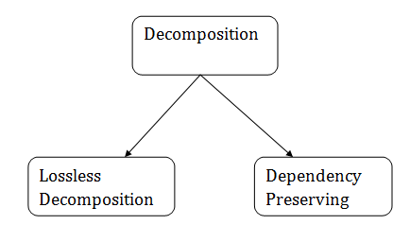
Types of Decomposition

Slide 4
Lossless Decomposition
If the information is not lost from the relation that is decomposed, then the decomposition will be lossless.
The lossless decomposition guarantees that the join of relations will result in the same relation as it was decomposed.
The relation is said to be lossless decomposition if natural joins of all the decomposition give the original relation.
Example:
EMPLOYEE_DEPARTMENT table:
EMP_ID | EMP_NAME | EMP_AGE | EMP_CITY | DEPT_ID | DEPT_NAME
22 | Denim | 28 | Mumbai | 827 | Sales
33 | Alina | 25 | Delhi | 438 | Marketing
46 | Stephan | 30 | Bangalore | 869 | Finance
52 | Katherine | 36 | Mumbai | 575 | Production
60 | Jack | 40 | Noida | 678 | Testing

Slide 5
The above relation is decomposed into two relations EMPLOYEE and DEPARTMENT EMPLOYEE table:
EMP_ID | EMP_NAME | EMP_AGE | EMP_CITY
22 | Denim | 28 | Mumbai
33 | Alina | 25 | Delhi
46 | Stephan | 30 | Bangalore
52 | Katherine | 36 | Mumbai
60 | Jack | 40 | Noida

Slide 6
DEPARTMENT table
DEPT_ID | EMP_ID | DEPT_NAME
827 | 22 | Sales
438 | 33 | Marketing
869 | 46 | Finance
575 | 52 | Production
678 | 60 | Testing

Slide 7
Now, when these two relations are joined on the common column "EMP_ID", then the resultant relation will look like: Employee ⋈ Department
EMP_ID | EMP_NAME | EMP_AGE | EMP_CITY | DEPT_ID | DEPT_NAME
22 | Denim | 28 | Mumbai | 827 | Sales
33 | Alina | 25 | Delhi | 438 | Marketing
46 | Stephan | 30 | Bangalore | 869 | Finance
52 | Katherine | 36 | Mumbai | 575 | Production
60 | Jack | 40 | Noida | 678 | Testing
Hence, the decomposition is Lossless join decomposition.

Slide 8
Dependency Preserving
It is an important constraint of the database.
In the dependency preservation, at least one decomposed table must satisfy every dependency.
If a relation R is decomposed into relation R1 and R2, then the dependencies of R either must be a part of R1 or R2 or must be derivable from the combination of functional dependencies of R1 and R2.
For example, suppose there is a relation R (A, B, C, D) with functional dependency set (A->BC). The relational R is decomposed into R1(ABC) and R2(AD) which is dependency preserving because FD A->BC is a part of relation R1(ABC).

Slide 9
Multivalued Dependency
Multivalued dependency occurs when two attributes in a table are independent of each other but, both depend on a third attribute.
A multivalued dependency consists of at least two attributes that are dependent on a third attribute that's why it always requires at least three attributes.
Example: Suppose there is a bike manufacturer company which produces two colors(white and black) of each model every year.

Slide 10
BIKE_MODEL | MANUF_YEAR | COLOR
M2011 | 2008 | White
M2001 | 2008 | Black
M3001 | 2013 | White
M3001 | 2013 | Black
M4006 | 2017 | White
M4006 | 2017 | Black
Here columns COLOR and MANUF_YEAR are dependent on BIKE_MODEL and independent of each other.
In this case, these two columns can be called as multivalued dependent on BIKE_MODEL. The representation of these dependencies is shown below:
BIKE_MODEL → → MANUF_YEAR
BIKE_MODEL → → COLOR
This can be read as "BIKE_MODEL multidetermined MANUF_YEAR" and "BIKE_MODEL multidetermined COLOR".

Slide 11
Join Dependency
Join decomposition is a further generalization of Multivalued dependencies.
If the join of R1 and R2 over C is equal to relation R, then we can say that a join dependency (JD) exists.
Where R1 and R2 are the decompositions R1(A, B, C) and R2(C, D) of a given relations R (A, B, C, D).
Alternatively, R1 and R2 are a lossless decomposition of R.
A JD ⋈ {R1, R2,..., Rn} is said to hold over a relation R if R1, R2,....., Rn is a lossless-join decomposition.
The *(A, B, C, D), (C, D) will be a JD of R if the join of join's attribute is equal to the relation R.
Here, *(R1, R2, R3) is used to indicate that relation R1, R2, R3 and so on are a JD of R.

Slide 12
Inclusion Dependency
Multivalued dependency and join dependency can be used to guide database design although they both are less common than functional dependencies.
Inclusion dependencies are quite common. They typically show little influence on designing of the database.
The inclusion dependency is a statement in which some columns of a relation are contained in other columns.
The example of inclusion dependency is a foreign key. In one relation, the referring relation is contained in the primary key column(s) of the referenced relation.
Suppose we have two relations R and S which was obtained by translating two entity sets such that every R entity is also an S entity.
Inclusion dependency would be happen if projecting R on its key attributes yields a relation that is contained in the relation obtained by projecting S on its key attributes.
In inclusion dependency, we should not split groups of attributes that participate in an inclusion dependency.
In practice, most inclusion dependencies are key-based that is involved only keys.

Slide 13
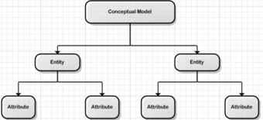
Database Design Strategies
Database Design Strategies
There are two approaches for developing any database, the top-down method and the bottom-up method. While these approaches appear radically different, they share the common goal of utilising a system by describing all of the interaction between the processes.
Top – down design method
The top-down design method starts from the general and moves to the specific. In other words, you start with a general idea of what is needed for the system and then work your way down to the more specific details of how the system will interact. This process involves the identification of different entity types and the definition of each entity’s attributes.

Slide 14
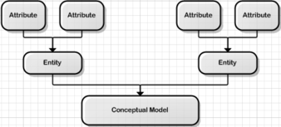
Bottom – up design method
The bottom-up approach begins with the specific details and moves up to the general. This is done by first identifying the data elements (items) and then grouping them together in data sets. In other words, this method first identifies the attributes, and then groups them to form entities.

Slide 15
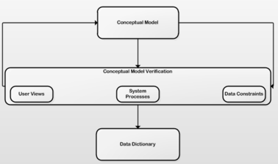
Centralized design
Centralized design is most productive when the data component is composed of a moderately small number of objects and procedures. The design can be carried out and represented in a somewhat simple database. Centralized design is typical of a simple or small database and can be successfully done by a single database administrator or by a small design team. This person or team will define the problems, create the conceptual design, verify the conceptual design with the user views, and define system processes and data constraints to ensure that the design complies with the organizations goals. That being said, the centralized design is not limited to small companies. Even large companies can operate within the simple database environment.

Slide 16
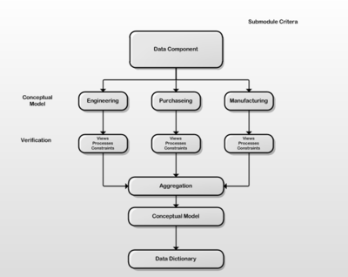
Decentralized design
Decentralized design might best be used when the data component of the system has a large number of entities and complex relations upon which complex operations are performed. This is also likely to be used when the problem itself is spread across many operational sites and the elements are a subset of the entire data set. In large and complex projects a team of carefully selected designers are employed to get the job done. This is commonly accomplished by several teams that work on different subsets or modules of the system. Conceptual models are created by these teams and compared to the user views, processes, and constraints for each module. Once all the teams have completed their modules they are all put aggregated into one large conceptual model.

